Slide 1
Git Demystified
Jimmy Bogard
@jbogard

Slide 2

CodeStock is proudly partnered with:
RecruitWise and Staff with Excellence - www.recruitwise.jobs
Send instant feedback on this session via Twitter:
Send a direct message with the room number to @CodeStock
d codestock 503 This session is great!
For more information on sending feedback using Twitter while at CodeStock, please see the “CodeStock README” in your CodeStock guide.

Slide 3

Wrox Press
Join the discussion
Facebook: www.facebook.com/wroxpress
Twitter: @wrox

Slide 4
Before we start…

Slide 5


Slide 6
C:\DontPanic

Slide 7
Version Control Basics

Slide 8
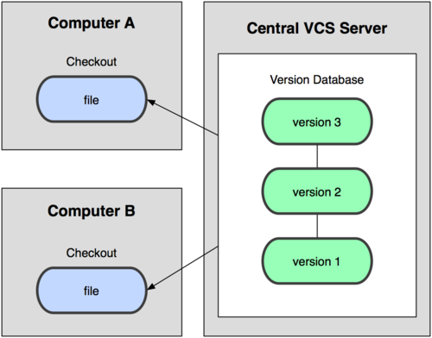
Centralized VCS
Notes:
Internet down, most/all operations require connection, slow

Slide 9
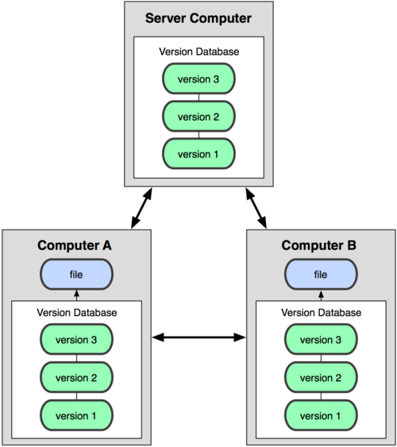
Distributed VCS
Notes:
Several models possible now – disconnected access, more advanced workflows

Slide 10
Git Intro

Slide 11
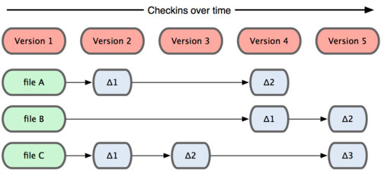
Most VCS databases

Slide 12
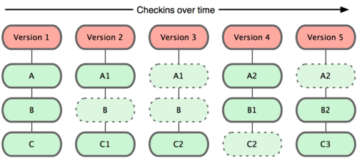
Git database
Notes:
Snapshots, not deltas = FAST
Not that big

Slide 13

Nearly every operation local
Notes:
Checkouts, merges, commits – local database = FAST

Slide 14

Commit with integrity
Notes:
All commits include a SHA-1 Hash as a checksum
All commits are referred to by that hash
Any modifications will change the hash

Slide 15
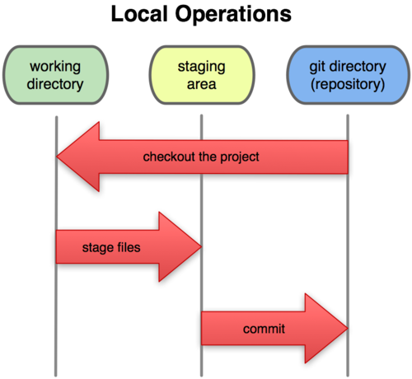
Three states

Slide 16
Installing Git

Slide 17

Good:
msysgit

Slide 18

Better:
gitextensions

Slide 19

Best:
gitextensions + p4merge

Slide 20
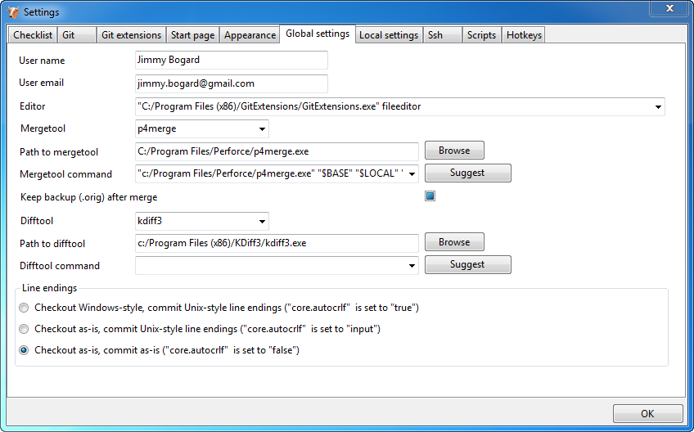

Slide 21
$ git <verb>

Slide 22
$ git help <verb>
$ git <verb> --help

Slide 23
Git Basics

Slide 24
Initializing a repository
$ git init
Initialized empty Git repository in c:/dev/gitfun/.git/

Slide 25
Cloning an existing repository
$ git clone git://github.com/jbogard/AutoMapper.git

Slide 26
Recording changes

Slide 27
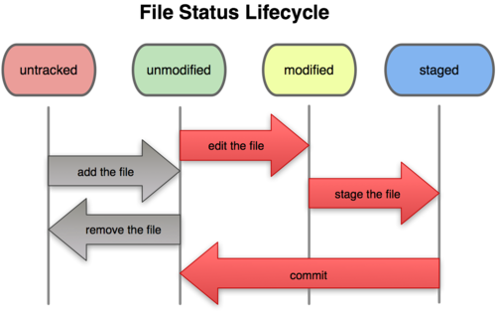

Slide 28
Checking status
$ git status
# On branch master
#
# Initial commit
#
nothing to commit (create/copy files and use "git add" to track)

Slide 29
Checking status
$ git status
# On branch master
#
# Initial commit
#
# Untracked files:
# (use "git add <file>..." to include in what will be committed)
#
# fun.txt
nothing added to commit but untracked files present (use "git add" to track)

Slide 30
Tracking files
$ git add fun.txt
OR
$ git add .

Slide 31
Tracking files
$ git status
# On branch master
#
# Initial commit
#
# Changes to be committed:
# (use "git rm --cached <file>..." to unstage)
#
# new file: fun.txt
#

Slide 32
Tracking files
$ git status
# On branch master
# Changed but not updated:
# (use "git add <file>..." to update what will be committed)
# (use "git checkout -- <file>..." to discard changes in working directory)
#
# modified: fun.txt
#
# Untracked files:
# (use "git add <file>..." to include in what will be committed)
#
# morefun.txt
no changes added to commit (use "git add" and/or "git commit -a")

Slide 33
Tracking files
$ git add .
$ git status
# On branch master
# Changes to be committed:
# (use "git reset HEAD <file>..." to unstage)
#
# modified: fun.txt
# new file: morefun.txt
#

Slide 34
Committing changes
$ git commit
OR
$ git commit -m "Adding some more fun"
[master 96ea437] Adding some more fun
1 files changed, 1 insertions(+), 0 deletions(-)
create mode 100644 morefun.txt

Slide 35
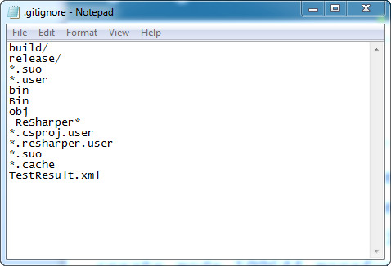
Ignoring files
$ notepad .gitignore

Slide 36
Removing files
$ git status
# On branch master
# Changed but not updated:
# (use "git add/rm <file>..." to update what will be committed)
# (use "git checkout -- <file>..." to discard changes in working directory)
#
# deleted: morefun.txt
#
no changes added to commit (use "git add" and/or "git commit -a")

Slide 37
Removing files
$ git rm morefun.txt
rm 'morefun.txt‘
OR
$ git add -A .
$ git status
# On branch master
# Changes to be committed:
# (use "git reset HEAD <file>..." to unstage)
#
# deleted: morefun.txt
#

Slide 38
Visualizing changes
$ git log
commit 96ea437805c8f9913a6e590f40c1cb841f12f581
Author: Jimmy Bogard <jimmy.bogard@gmail.com>
Date: Sat Jun 4 12:12:17 2011 -0500
Adding some more fun
commit 5245c8b51d083f9fd50d3447381bc4db4e7df1c0
Author: Jimmy Bogard <jimmy.bogard@gmail.com>
Date: Sat Jun 4 11:50:01 2011 -0500
Adding some fun

Slide 39
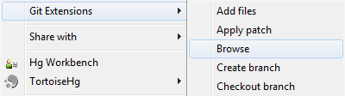
Git Extensions - browse

Slide 40
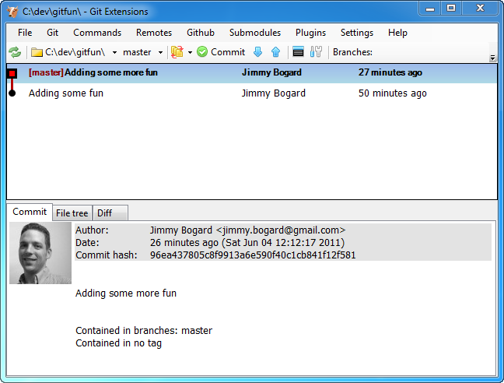
Git Extensions - browse

Slide 41
Remotes

Slide 42
Showing remotes
$ git clone git@github.com:jbogard/AutoMapper.git AutoMapper2
Cloning into AutoMapper2...
remote: Counting objects: 4037, done.
remote: Compressing objects: 100% (1530/1530), done.
remote: Total 4037 (delta 2624), reused 3826 (delta 2448)
Receiving objects: 100% (4037/4037), 30.27 MiB | 575 KiB/s, done.
Resolving deltas: 100% (2624/2624), done.
$ cd AutoMapper2
$ git remote
origin

Slide 43
Fetching changes
$ git fetch origin

Slide 44
Pushing changes
$ git push origin master

Slide 45
The Good Stuff (Branching)

Slide 46
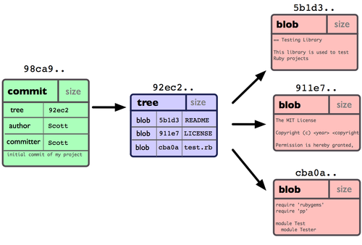
Anatomy of a commit

Slide 47
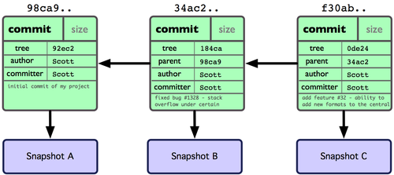
Multiple Commits

Slide 48
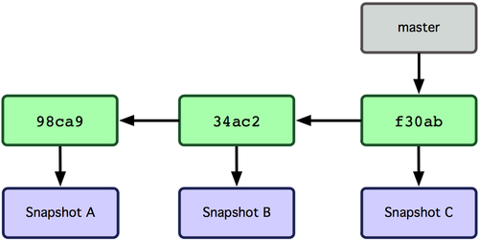
Branches

Slide 49
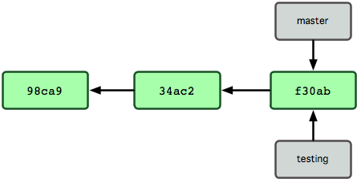
Creating a branch
$ git branch testing

Slide 50
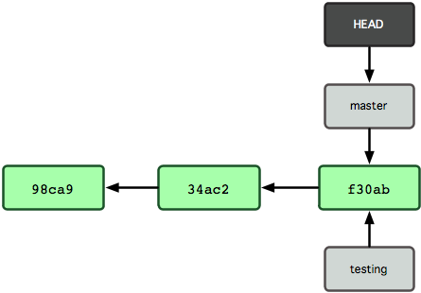
The HEAD pointer

Slide 51
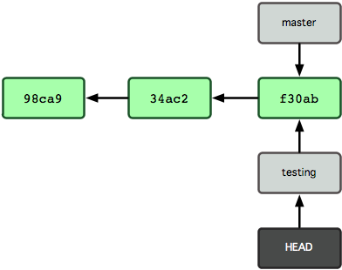
Switching branches
$ git checkout testing

Slide 52
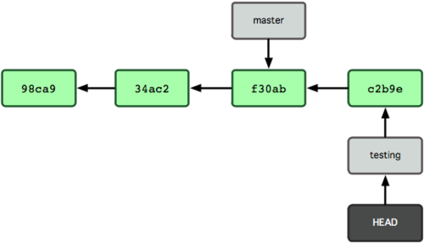
Making a change
$ git commit -m "Made a change"

Slide 53
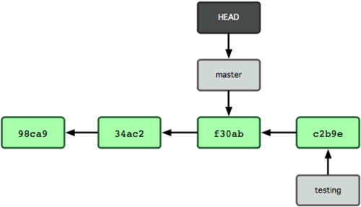
Switching again
$ git checkout master

Slide 54
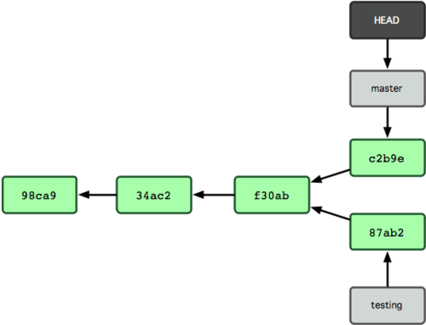
More changes
$ git commit -m "More changes"

Slide 55
Inside a branch
Notes:
A branch in Git is a file that contains the hash of the commit being pointed to. File name = branch name

Slide 56
Basic branching and merging

Slide 57
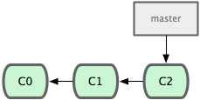
Initial state

Slide 58
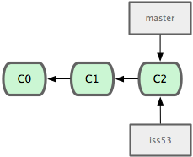
A bug comes in
$ git checkout -b iss53

Slide 59
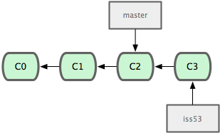
Applying a fix
$ git commit -a -m 'fixing issue'

Slide 60
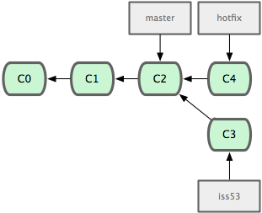
Hotfix needed ASAP!
$ git checkout -b 'hotfix' $ git commit -a -m 'fixed'

Slide 61
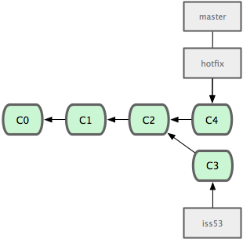
Hotfix needed ASAP!
$ git checkout master
$ git merge hotfix

Slide 62
Deleting the branch
$ git branch -d hotfix

Slide 63
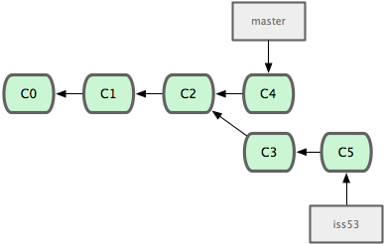
Going back to the bug
$ git checkout iss53
$ git commit -a -m "More fixes"

Slide 64
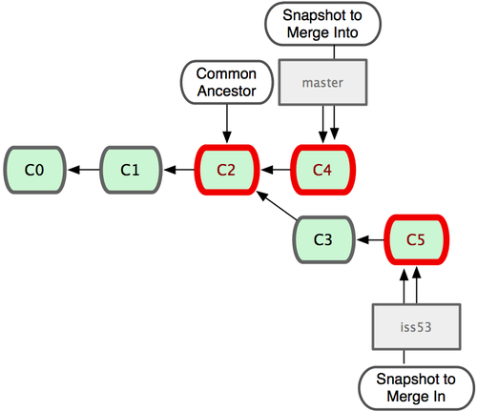
Merging the issue back to master
$ git checkout master
$ git merge iss53

Slide 65
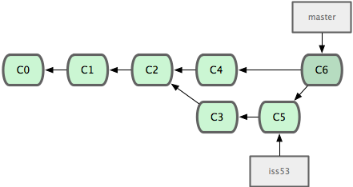
After the merge

Slide 66
Rebasing

Slide 67
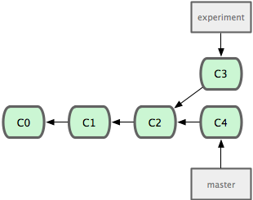
Divergent commits

Slide 68
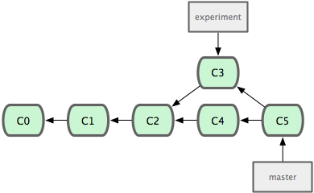
A merge
$ git checkout master
$ git merge experiment

Slide 69
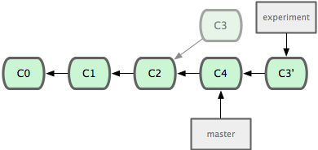
Rebase
$ git checkout experiment
$ git rebase master

Slide 70
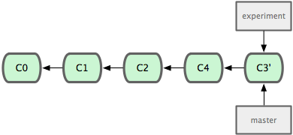
Fast-forward merge
$ git checkout master
$ git rebase experiment

Slide 71
Rules
Notes:
Don’t rebase upstream commits
Rebase on pull
Merge between branches

Slide 72
Why git?
Notes:
Fast
Everything is local
Branching is EXTEREMELY cheap
Tool extremely flexible, can support a wide, wide variety of developer workflows
Free!
Github

Slide 73
For more info
http://progit.org/
http://git-scm.com/
http://gitready.com/
http://www.ndpsoftware.com/git-cheatsheet.html
Images from http://progit.org/book/

